Slide 1



A Blockchain-driven system for authenticity, sustainability and export readiness of ayurvedic herbs
Under the guidance of Prof. Jayesh Rane
and Vijen Gala
By
Aditya Rajesh Srinivas - 16014022115
Shreya Vikas Jhamb - 16014022121
1

Slide 2
OUTLINE
Sr. No. | Name of the Slide | Slide No.
1 | Introduction & Background | 3
2 | Problem Statement | 4
3 | Literature Survey | 5-7
5 | Objectives of the project | 8
6 | Methodology & Proposed Approach | 9
7 | System Architecture and workflow | 10-11
8 | Work Done Till Now | 12-13
9 | Preliminary work (screen shots) | 14-15
10 | Conclusion & QnA | 16
11 | References | 17
2

Slide 3
Introduction
Ayurveda is one of the world’s oldest holistic healing systems originating in India over 5,000 years ago.
The Ayurveda industry focuses on natural and herbal products used for healthcare, wellness and preventive medicine.
In recent years the industry has seen rapid global growth due to increasing demand for organic and plant-based solutions.
Current systems exist but they are extremely isolated and dont provide a unified, scalable and export ready solution which the market needs.
Challenges such as lack of standardization, authenticity verification and traceability in the supply chain highlight the need for advanced technological solutions
3

Slide 4
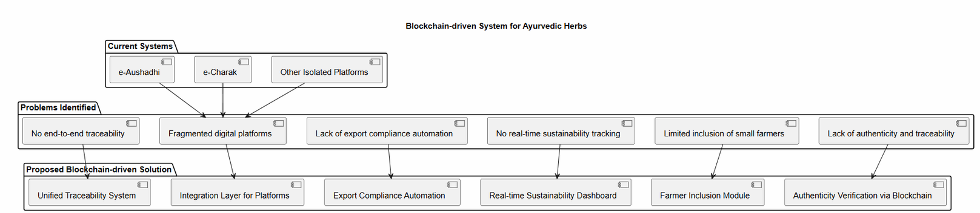
Problem Statement
Our Problem statement is “A Blockchain-driven system for authenticity,sustainability and export readiness of ayurvedic herbs” which will answer the following queries:-
No end-to-end traceability system
Fragmented digital platforms (e-Aushadhi, e-Charak)
Lack of export compliance automation
No real-time sustainability tracking
Limited inclusion of small farmers
Lack of authenticity and traceability
4

Slide 5
Literature Survey
Ref | Paper Name | Model / Technique | Dataset Used | Strengths | Limitations
1 | Comparative Study of Convolutional Neural Networks for Leaf Classification in Ayurveda | Convolutional Neural Networks (VGG-16, ResNet-50, EfficientNet-V2M) | 1,835 images of 30 Ayurvedic plant species | EfficientNet-V2M achieved 98.24% accuracy with fast training time | Performance varies with lighting conditions and complex backgrounds
2 | End-to-End Traceability in Ayush Drug Supply Chains: Challenges, Opportunities, and Policy Perspectives | Artificial Intelligence enabled Blockchain with Quick Response Codes | Analysis of e-Aushadhi and e-Charak portals | Provides comprehensive regulatory roadmap for global compliance standards | Largely conceptual and requires significant infrastructure in rural areas
3 | Leveraging Deep Learning and Blockchain for Enhanced Transparency and Traceability in the Indian Herbal Product Supply Chain | Hyperledger Fabric Blockchain with Sequential Convolutional Neural Network | 20-class medicinal plant image dataset | Enables real-time tracking and prevents data tampering through immutable ledger | Lower classification accuracy compared to standalone deep learning models
4 | Segmented Encryption: A Quality and Safety Supervisory Model for Herbal Medicine Based on Blockchain Technology | Blockchain Technology with Smart Contracts and Radio Frequency Identification / Quick Response Codes | Global herbal product lifecycle data | Provides secure seed-to-shelf monitoring with high transparency | High implementation cost for small-scale farmers and producers
5 | MedicLedger: Blockchain-Based Supply Chain Architecture for Ayurvedic Product Authentication and Compliance | Decentralized Ethereum Blockchain Network | Transactional data of herbal raw materials | Eliminates intermediaries and ensures fair pricing for farmers | Scalability challenges and high transaction (gas) fees
5

Slide 6
Literature Survey
Ref | Paper Name | Model / Technique | Dataset Used | Strengths | Limitations
6 | DNA Barcoding of the Market Samples of Single-Drug Herbal Powders Reveals Adulteration with Taxonomically Unrelated Plant Species | DNA Barcoding using ribulose-bisphosphate carboxylase (rbcL) marker | 107 single-drug herbal powder samples covering 65 species | Highly accurate identification of species even in processed powders | Requires expert laboratory setup and high-quality genomic DNA
7 | Traceability System for Rare Chinese Herbal Medicines Based on Blockchain Structure | Double Blockchain Architecture (Private Blockchain and Consortium Blockchain) with InterPlanetary File System | Multi-modal supply chain records including images and transaction logs | Efficient storage of large files off-chain while maintaining secure logs | Increased technical complexity due to dual blockchain architecture
8 | Demystifying Hyperledger Fabric Framework for Distributed Ledgers and Approach to Evaluate Its Performance | Permissioned Blockchain using Hyperledger Fabric Framework | Simulated multi-organization network transactions | Provides high throughput, low latency, and strong privacy control | Requires advanced technical expertise for setup and maintenance
9 | Integrating Artificial Intelligence and Data Analytics for Supply Chain Optimization in the Pharmaceutical Industry | Artificial Intelligence with Predictive Data Analytics and Blockchain Integration | Historical production, demand, and distribution datasets | Enables accurate demand forecasting and secure supply chain optimization | Requires large volumes of high-quality historical data
10 | HerBChain, a Blockchain-Based Informative Platform for Quality Assurance and Quality Control of Herbal Products | Consortium Blockchain using Openchain Framework with Quick Response Codes | Six-stage herbal product manufacturing lifecycle data | Minimizes manipulation of quality records across stakeholders | Faces resistance in adoption among traditional industry participants
6

Slide 7
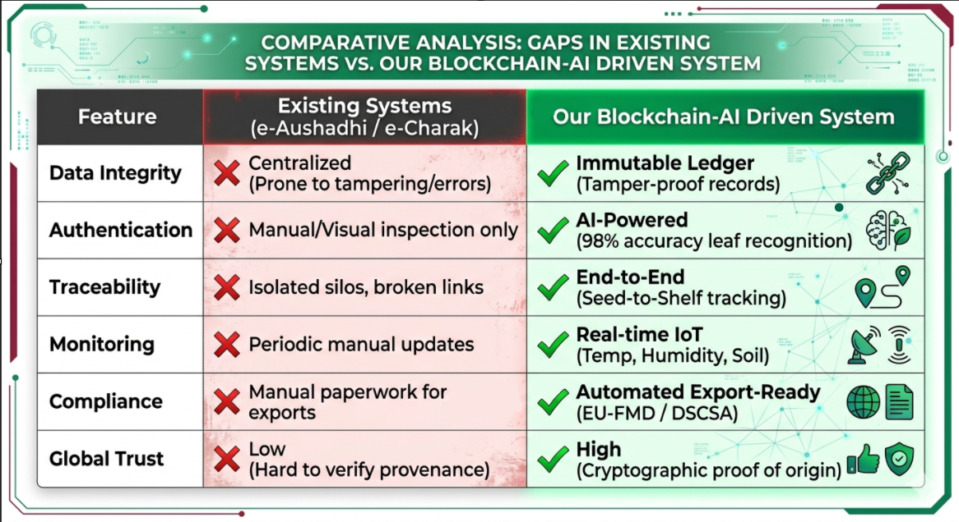
Literature review (Summary)
While technologies exist there is no single system to do it all.
Existing System:-
Blockchain traceability systems
CNN models (up to 98% accuracy)
Government portals
Gaps identified:-
No unified system
No export automation
Limited scalability and authentication
Weak sustainability tracking
7

Slide 8
Objectives of the project
Implementing blockchain-based traceability using Hyperledger Fabric to ensure security making for a tamper-proof and transparent tracking of Ayurvedic herbs across the supply chain.
Evaluate and optimizing system performance using Hyperledger Caliper for benchmarking throughput latency and scalability.
Developing an AI-based herb authentication system using a CNN model (MobileNetV5) to accurately classify and verify herbal products.
Enabling software-based geo-tagging using browser Geolocation API to capture real-time herb origin and location data without IoT dependency.
Implementing a QR code-based verification system to allow consumers to instantly verify product authenticity and traceability.
Designing a mobile-first, multilingual web platform for accessibility across diverse users including farmers, regulators, and consumers.
Incorporating export compliance support aligned with global regulations such as EU Falsified Medicines Directive and Drug Supply Chain Security Act to facilitate international trade readiness.
8

Slide 9
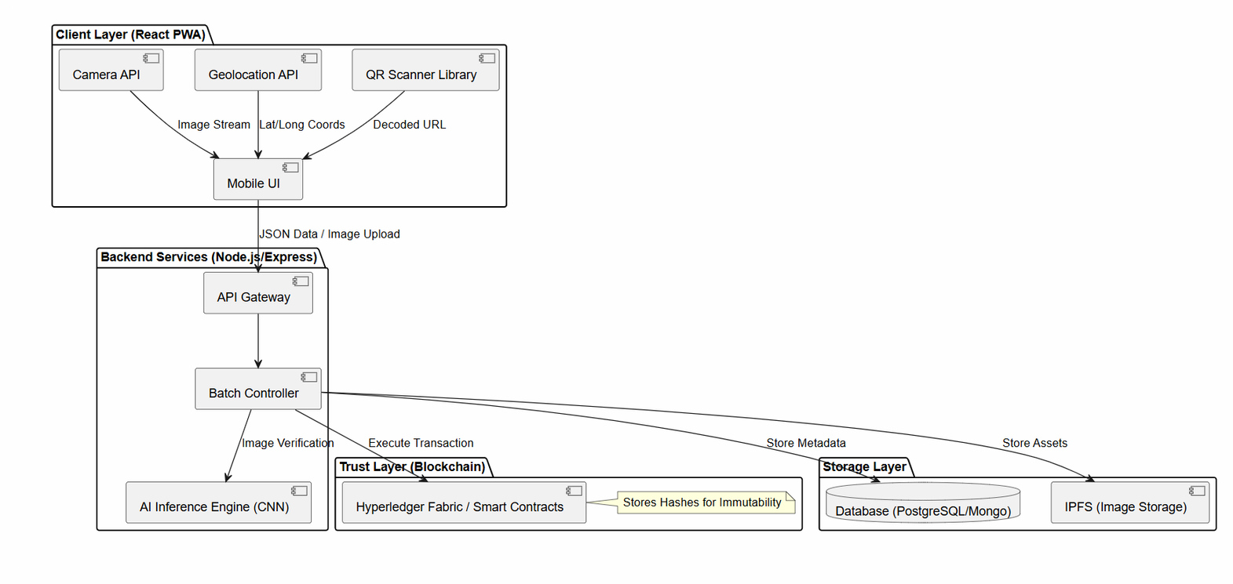
Methodology
1) Capture & Collect
Farmers or users simply scan, click, or upload through the website and add their input in the system with images, location, and product data.
2)Verify & Validate
AI acts like a digital inspector making sure checking images and data for authenticity before anything moves forward.
3)Seal with Trust
Blockchain locks each verified record, giving it a tamper-proof stamp of authenticity and sustainability.
4)Store & Share Transparently
Metadata and images are safely stored in databases and IPFS (interplanetary file system) making the system auditable, scalable, and ready for global exports.
9

Slide 10
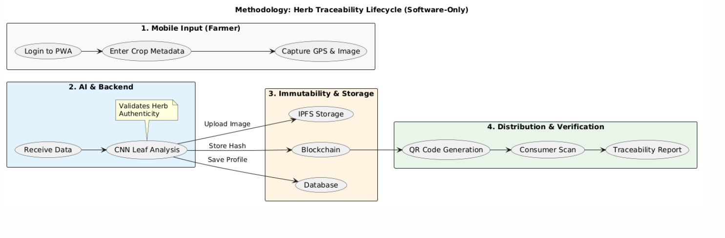
System workflow
10

Slide 11
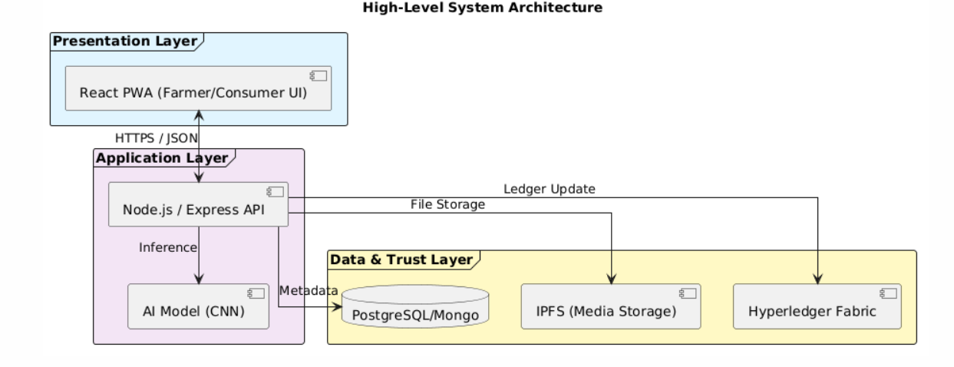
System Architecture
11

Slide 12
Work done till now ( frontend part)
Developed a mobile-first, multilingual Single Page Application (SPA) using React 18, TypeScript, Vite, and Tailwind CSS for Ayurvedic herb traceability.
Implemented internationalization using react-i18next, supporting 10 languages with automatic browser language detection and persistent user preference via localStorage.
Designed a modern, responsive UI/UX with glassmorphism, dark mode, and smooth animations using Framer Motion, ensuring accessibility with ARIA labels and keyboard navigation.
Built a QR-based verification system using jsQR, enabling real-time camera scanning, image upload-based scanning, and manual batch ID verification.
Developed a complete herb traceability workflow: Upload → AI Verification → Blockchain Record → QR Code Generation → Consumer Verification.
Structured the application using a modular and scalable architecture, including reusable components, custom hooks, and an organized directory structure.
Optimized styling and class management using Tailwind CSS, clsx, and tailwind-merge.
Built and configured the application using Vite for fast development, hot module replacement, and optimized production builds.
Implemented a feature-rich upload system with drag-and-drop image upload, automatic geo-tagging using the browser Geolocation API, batch metadata input (herb name, location, harvest date, quantity, farmer ID), and real-time progress indicators with success and error states.
Developed a verification module displaying herb details and origin, AI confidence score, verification timestamp, and blockchain hash to ensure transparency.
Created a consumer dashboard featuring user-specific statistics, upload history tracking, and activity monitoring.
Integrated an AI chatbot interface for user assistance and interaction.
12

Slide 13
Work done till now ( CNN part)
Data Preprocessing & Augmentation
Applied ImageDataGenerator for preprocessing and augmentation:
Rescaling pixel values (1./255 normalization)
Rotation (30°)
Zoom (0.3)
Horizontal flipping
Shear transformation (0.2)
Brightness variation (0.8–1.2)
Split dataset using 80% training / 20% validation
Dataset contains 1300+ images across 10 herb classes
Training Configuration
Epochs: 50
Batch size: 16
Optimizer: Adam (learning rate = 0.0001)
Loss function: Categorical Crossentropy
Metrics: Accuracy
Implemented Early Stopping:
- Monitors validation loss
- Patience = 5
- Restores best model weights
Model Evaluation
Generated predictions on validation dataset
Evaluated using:
- Confusion Matrix (visualized using Seaborn heatmap)
- Classification Report (Precision, Recall, F1-score)
- Achieved approximately:
- ~85% validation accuracy
- Strong performance across most herb categories
Visualization
Plotted:
- Training vs Validation Accuracy curves
- Training vs Validation Loss curves
- Used Matplotlib for performance analysis
Model Architecture
Base model: MobileNetV5 (feature extractor)
Fine-tuned by freezing all layers except last ~30 layers
Custom classification head:
- GlobalAveragePooling2D (reduces spatial dimensions)
- Dense layer (256 units, ReLU activation)
- Dropout (0.5) for regularization
- Dense layer (128 units, ReLU activation)
- Dropout (0.3)
- Output layer with Softmax activation (multi-class classification)
13

Slide 14
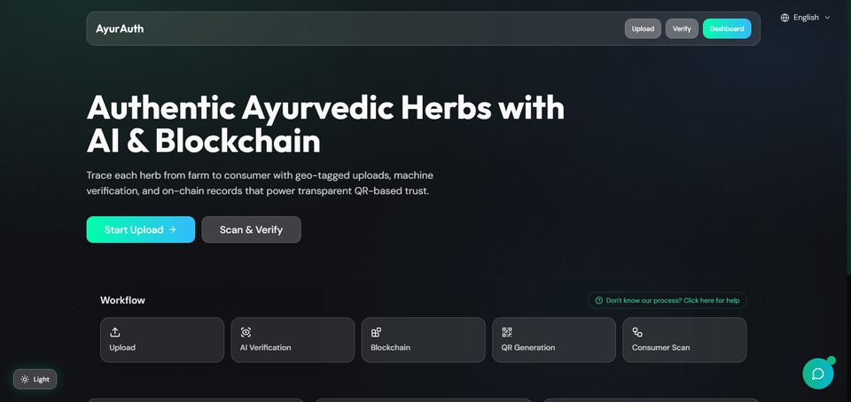
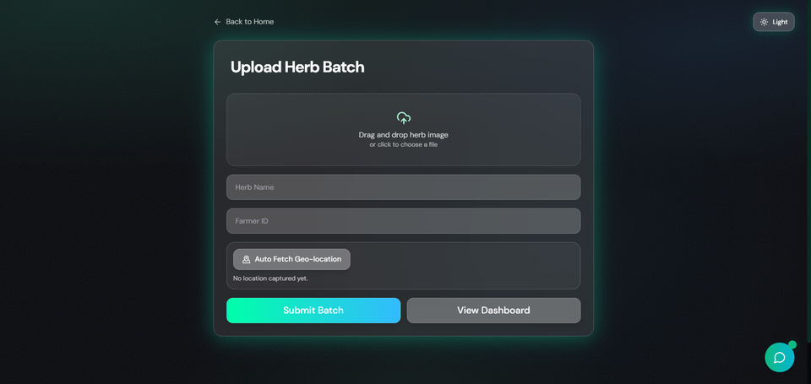
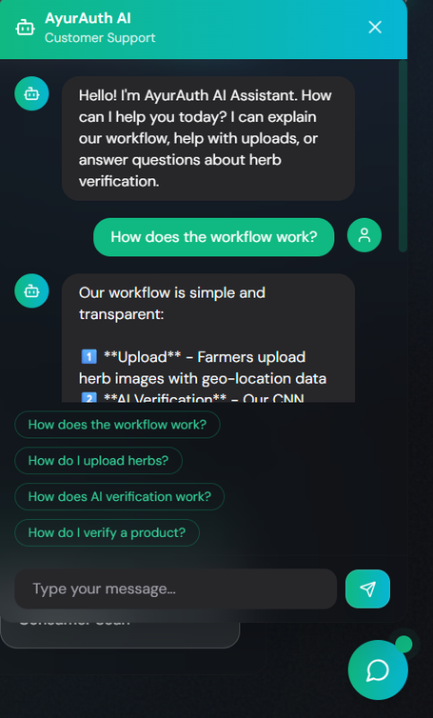
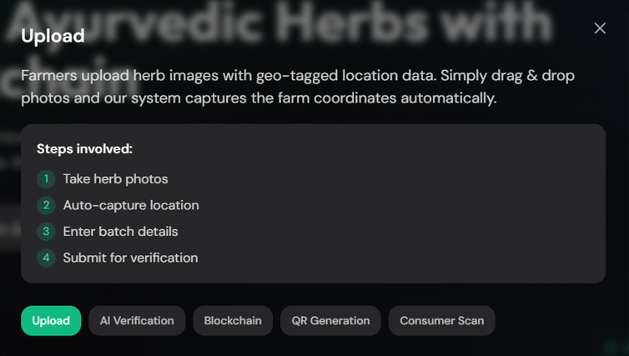
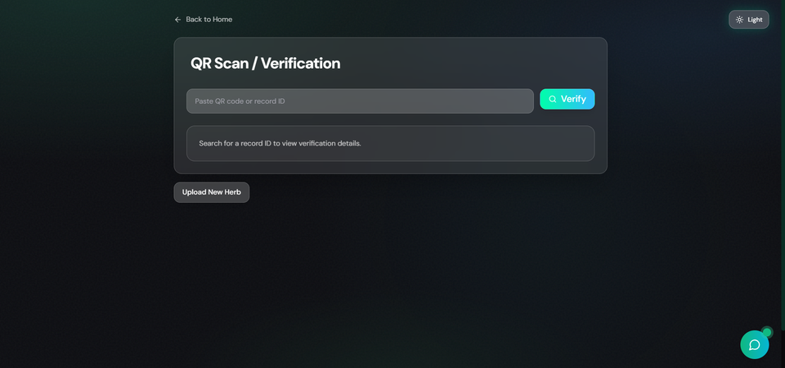
Implementation (Screenshots)
14

Slide 15
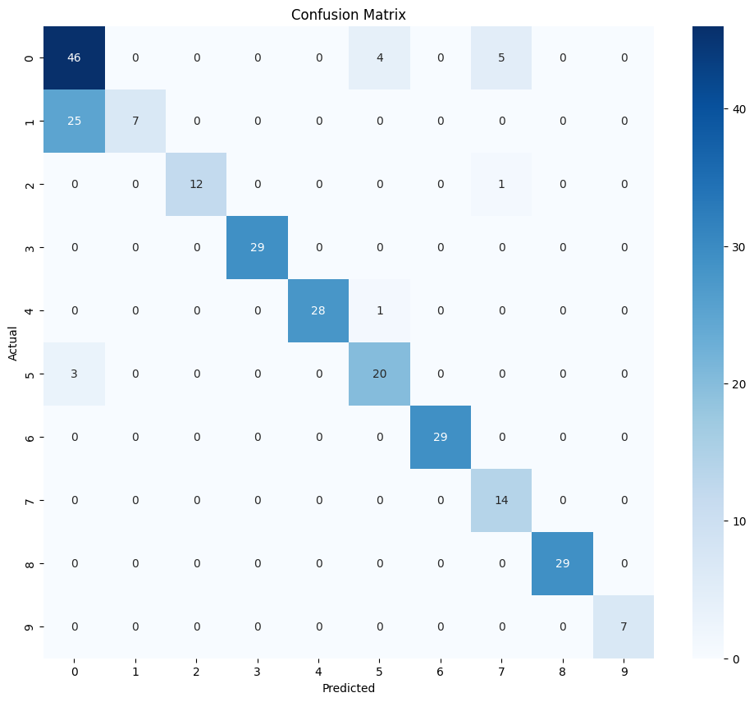
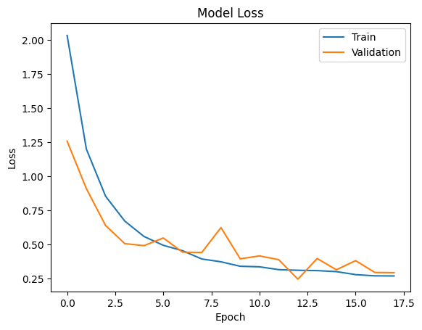
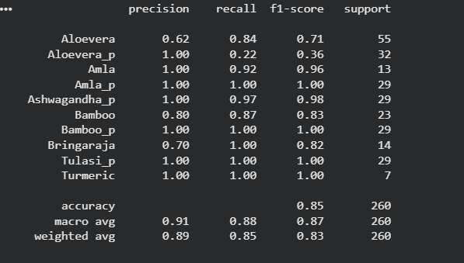
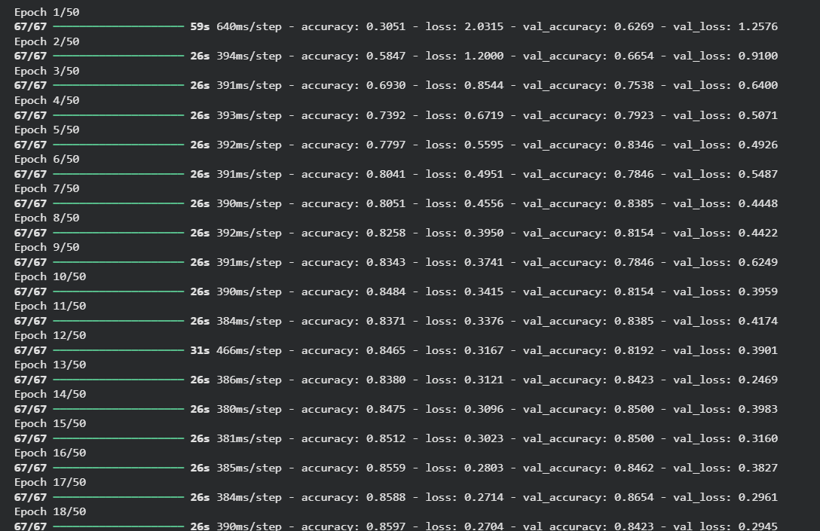
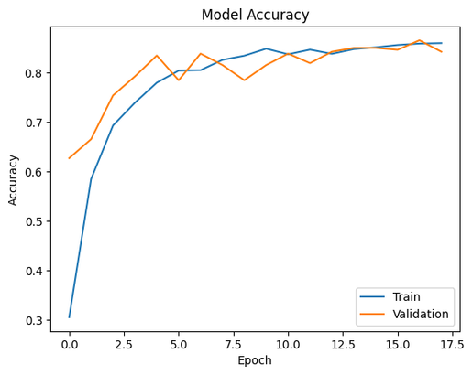
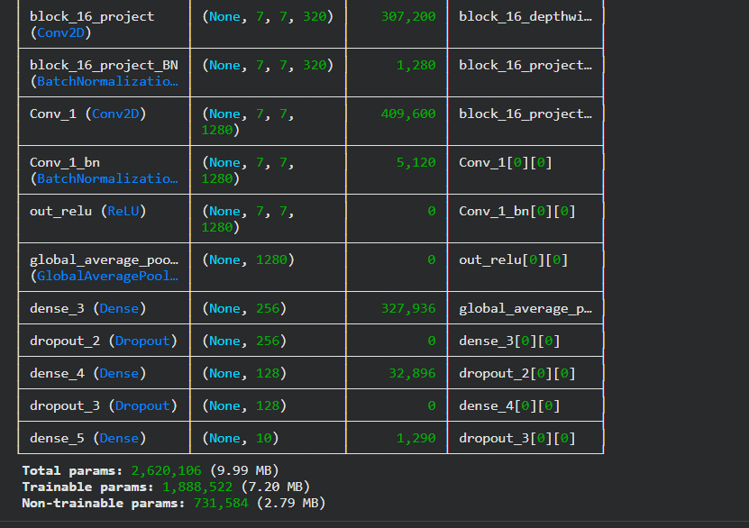
Implementation (Screenshots)
15

Slide 16
Conclusion and QnA
Our vision is to create a trusted and globally scalable ecosystem which is able to:-
Do authentication for herbs and validate its purity
Create a transparent supply chain network
Introduce SDGs and create a system for sustainable farming
Export ready ecosystem
Inclusive for farmers
THANK YOU
16

Slide 17
References
Kunjachan, S., Remya, R., Kumar, S., Asish, G. R., Sheela, K., & Kala, S. (2023). Comparative Study of Convolutional Neural Networks for Leaf Classification in Ayurveda. International Conference on Green Energy, Computing and Intelligent Technology (GEn-CITy 2023), 10–12 July 2023.
Kaushik, R., Kumar, S., & Pathak, S. (2025). End-to-end traceability in Ayush drug supply chains: Challenges, opportunities, and policy perspectives. International Journal of Ayurveda Research, 6(4), 379–386. https://doi.org/10.4103/ijar.ijar_318_25
Uniyal, P., Singh, C., & Dinesh, G. (n.d.). Leveraging Deep Learning and Blockchain for Enhanced Transparency and Traceability in the Indian Herbal Product Supply Chain. Dept of Computational Intelligence, School of Computing, SRM Institute of Science and Technology.
Liu, J., Peng, S., Luo, J., Tang, Z., & Liu, H. (2021). Segmented Encryption: A Quality and Safety Supervisory Model for Herbal Medicine Based on Blockchain Technology. IEEE International Conference on E-health Networking, Application & Services (HEALTHCOM).
Rout, S. K. (2025). MedicLedger: Blockchain-Based Supply Chain Architecture for Ayurvedic Product Authentication and Compliance. International Journal of Computer Engineering and Technology (IJCET), 16(1), 1706–1721. https://doi.org/10.34218/IJCET_16_01_125
Balaji, R., & Parani, M. (2022). DNA Barcoding of the Market Samples of Single-Drug Herbal Powders Reveals Adulteration with Taxonomically Unrelated Plant Species. Diversity, 14(495). https://doi.org/10.3390/d14060495
Liu, H., Dong, J., & Ge, S. (2021). Traceability System for Rare Chinese Herbal Medicines Based on Blockchain Structure. 3rd International Conference on Artificial Intelligence and Advanced Manufacture (AIAM), 382–385.
Kaushal, R. K., Kumar, N., Makka, S., & Saluja, K. (2023). Demystifying Hyperledger Fabric Framework for Distributed Ledgers and Approach to Evaluate Its Performance. International Conference on Sustainable Emerging Innovations in Engineering and Technology (ICSEIET), 116–120. https://doi.org/10.1109/ICSEIET58677.2023.10303377
Reddy, P. K., Mane, A., Islam, A., Singh, R., & Khatoon, F. (2024). Integrating artificial intelligence and data analytics for supply chain optimization in the pharmaceutical industry. International Journal of Intelligent Systems and Applications in Engineering, 12, 934–941.
Yik, M. H.-Y., Wong, V. C.-W. T., Wong, T.-H., & Shaw, P.-C. (2021). HerBChain, a blockchain-based informative platform for quality assurance and quality control of herbal products. Journal of Traditional and Complementary Medicine, 11(6), 598–600. https://doi.org/10.1016/j.jtcme.2021.07.005
17

